Slide 1

Customer Segmentation-Unsupervised Clustering
Data Science With Python
Atharva Deepak Sharma

Slide 2
Steps Involved
1.IMPORTING LIBRARIES
2. LOADING DATA
3. DATA CLEANING
4. DATA PREPROCESSING
5. DIMENSIONALITY REDUCTION
6. CLUSTERING
7. EVALUATING MODELS
8. PROFILING
9. CONCLUSION
10.END

Slide 3
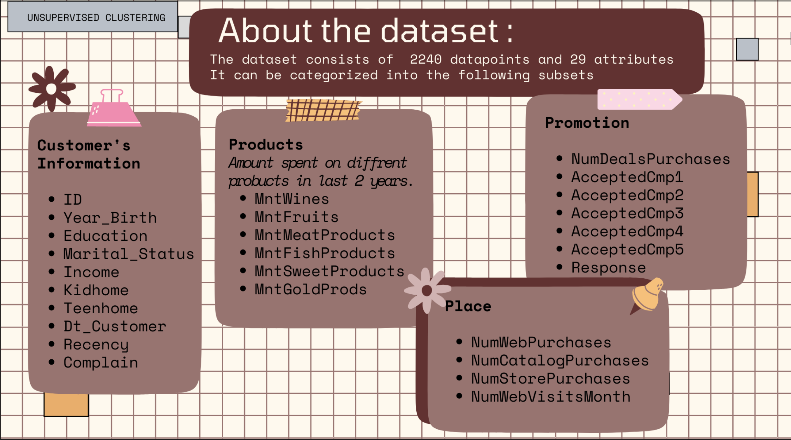

Slide 4
Step 1
Importing Libraries
NumPy: Used for numerical computations and array manipulation.
Pandas: Used for data manipulation and analysis using DataFrames.
Datetime: Handles date and time operations.
Matplotlib: Used for 2D/3D plotting and data visualization.
Seaborn: Statistical data visualization based on Matplotlib.
scikit-learn (sklearn)
LabelEncoder (categorical encoding), StandardScaler (data normalization), PCA (dimensionality reduction), KMeans (clustering), AgglomerativeClustering (hierarchical clustering), metrics (model evaluation)
Yellowbrick: Visual analysis for selecting the optimal number of clusters.
Sys Used for system-specific parameters and functions.

Slide 5
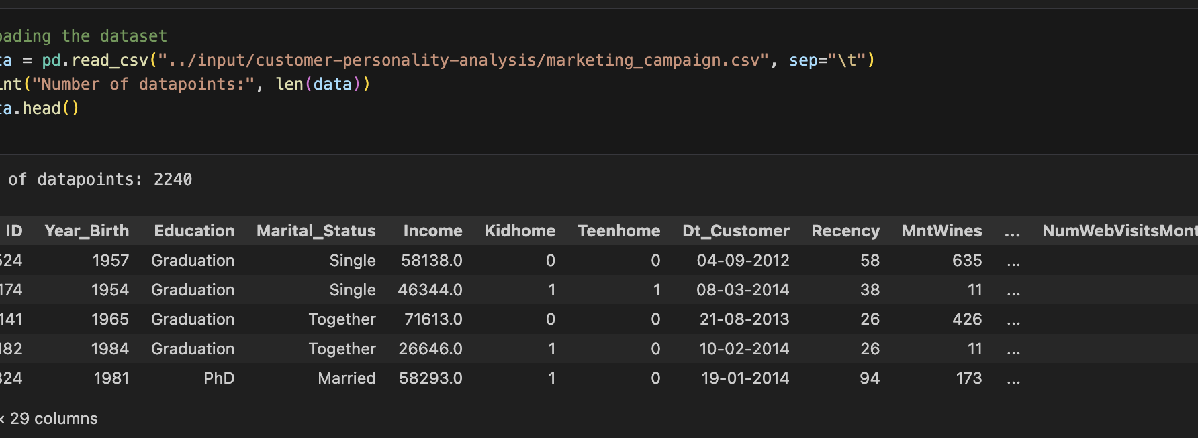
Step 2: Loading Data

Slide 6
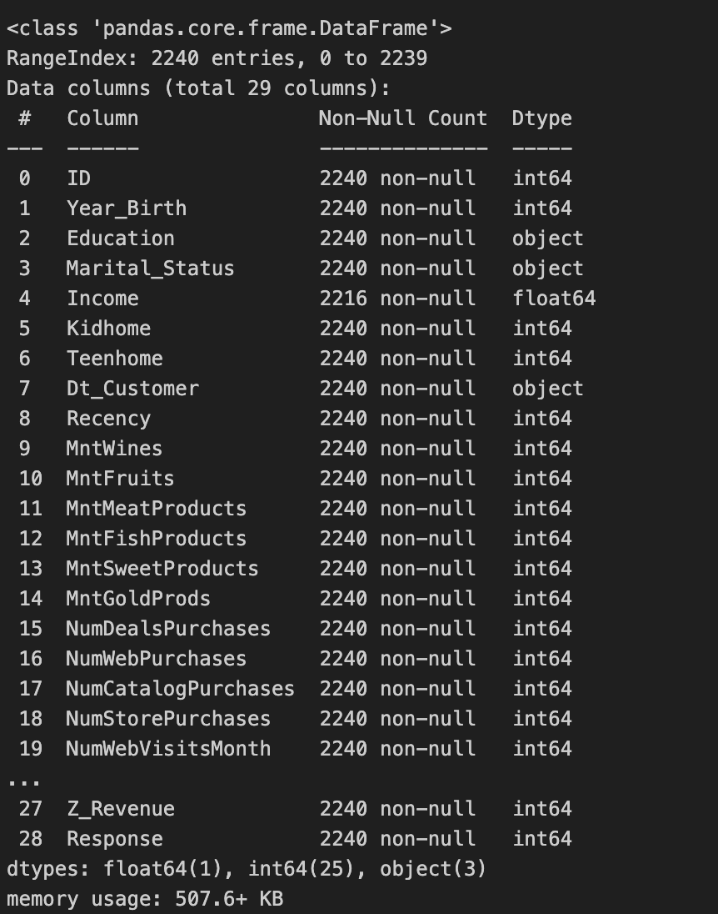
Step3:Data cleaning

Slide 7
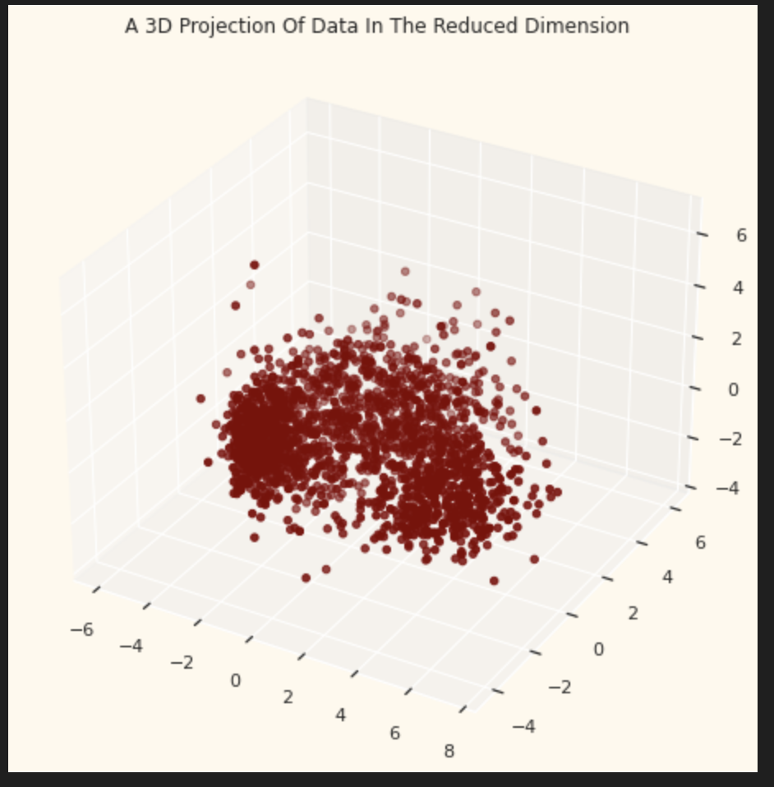
Dimensionality Reduction
.
In Dimensionality reduction is the process of reducing the number of random variables under consideration, by obtaining a set of principal variables
Principal component analysis (PCA) is a technique for reducing the dimensionality of such datasets, increasing interpretability but at the same time minimizing information loss.
For this project, I will be reducing the dimensions to 3.

Slide 8
CLUSTERING
Steps involved in the clustering
Elbow Method to determine the number of clusters to be formed
K-Means Clustering
Clustering via Agglomerative Clustering
Examining the clusters formed via scatter plot

Slide 9
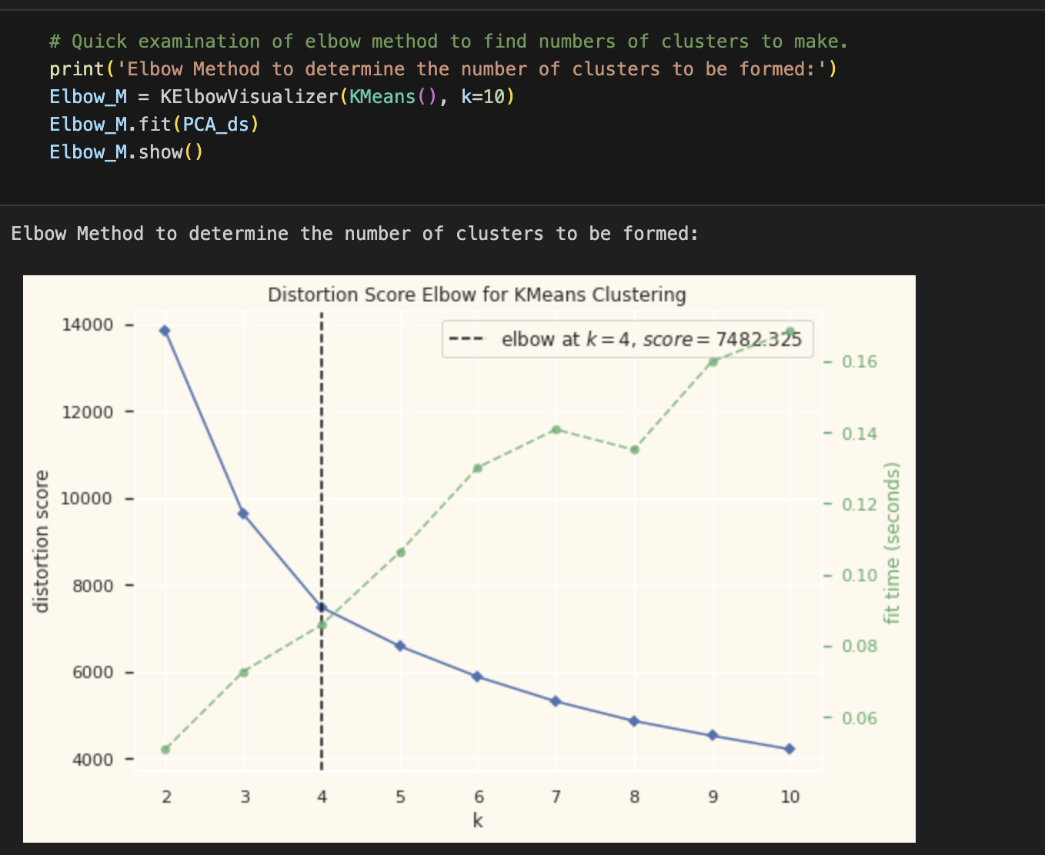
ELBOW METHOD

Slide 10
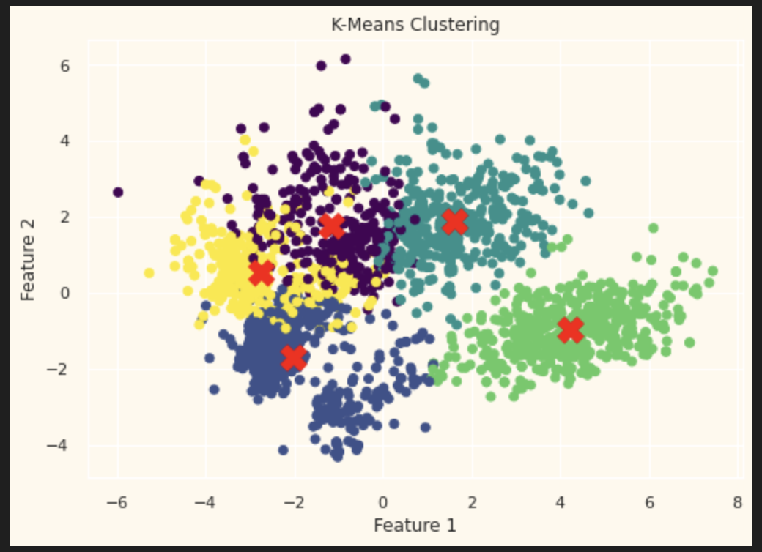
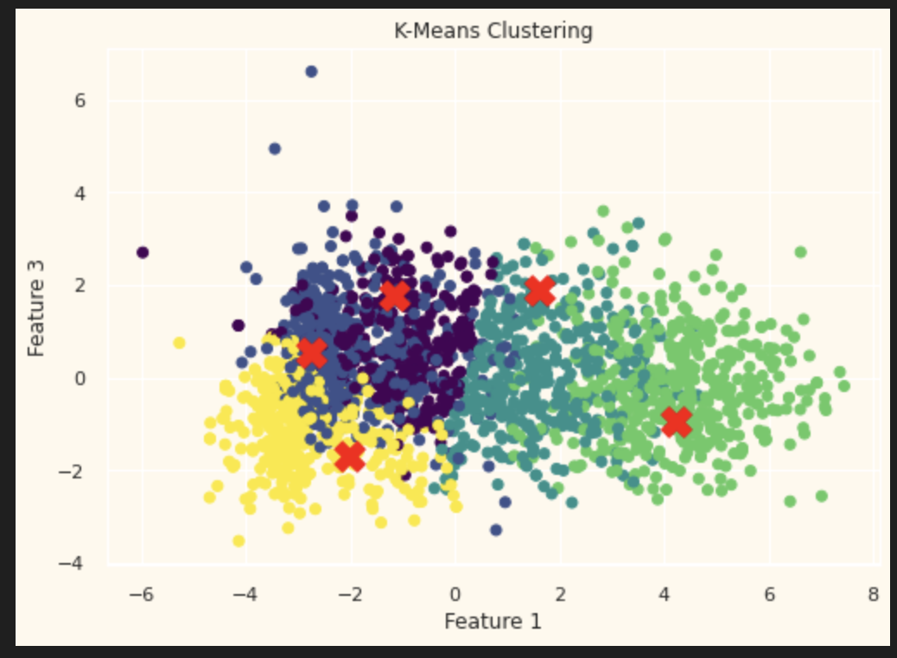
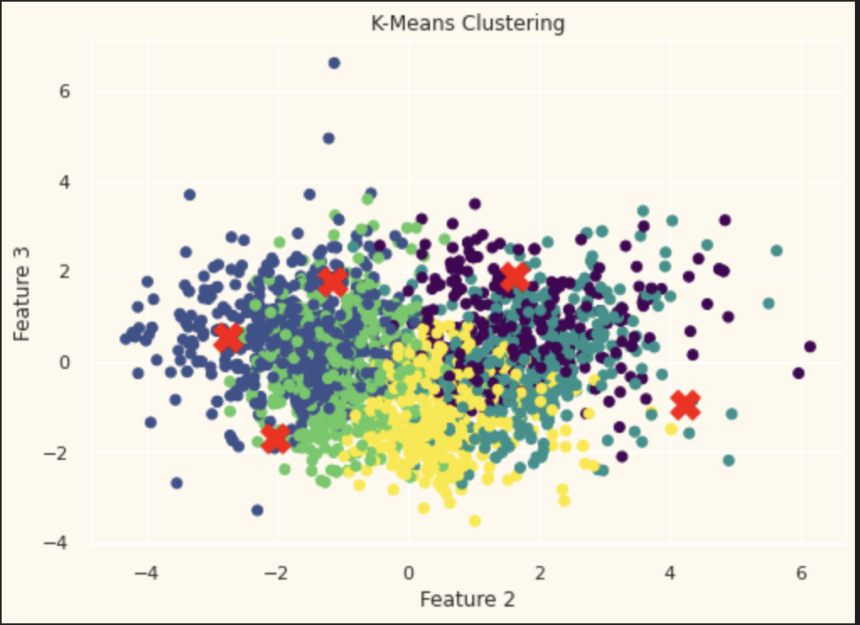
K-means clustering

Slide 11
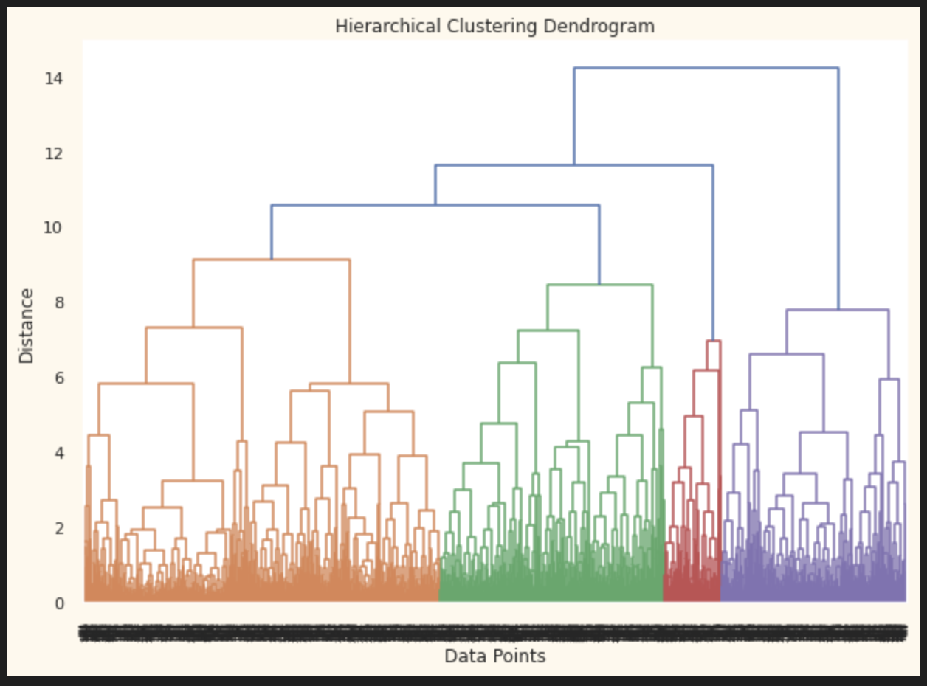
Dendrogram
In your dendrogram:
The largest vertical gap before things start merging too tightly appears at around height 10–11.
If you cut there, you’ll get 4 distinct clusters (orange, green, red, purple).
Optimal number of clusters (k) = 4

Slide 12
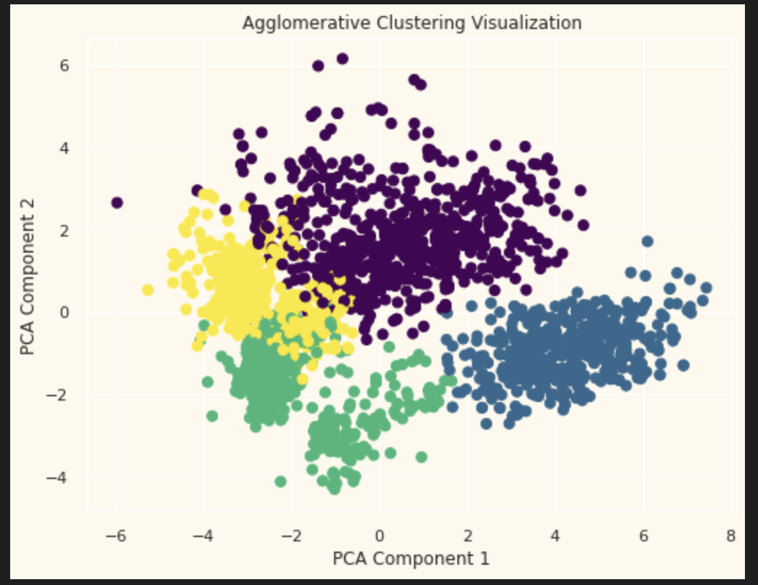
Agglomerative clustering visualization

Slide 13
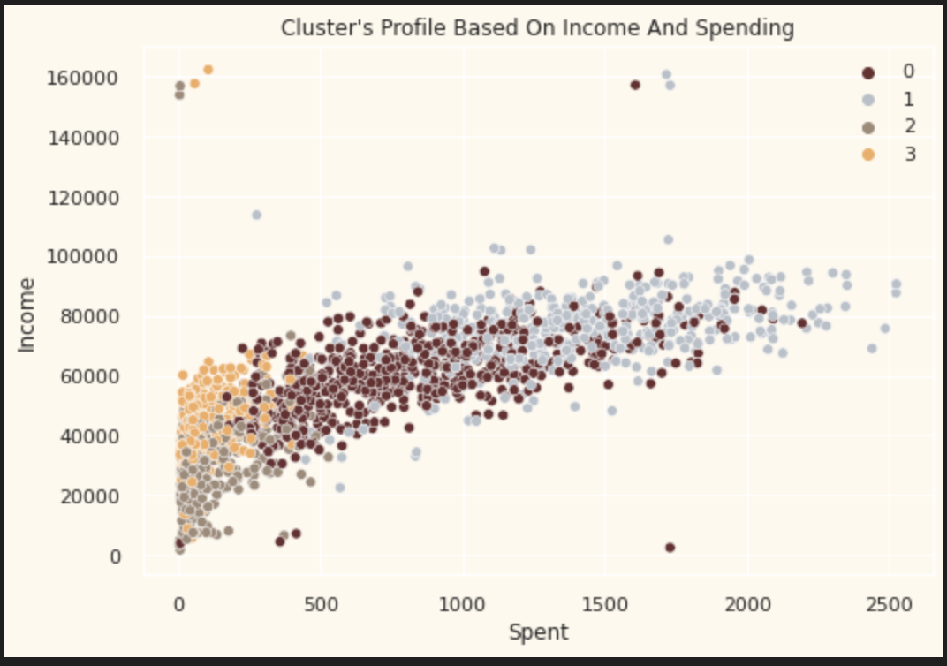
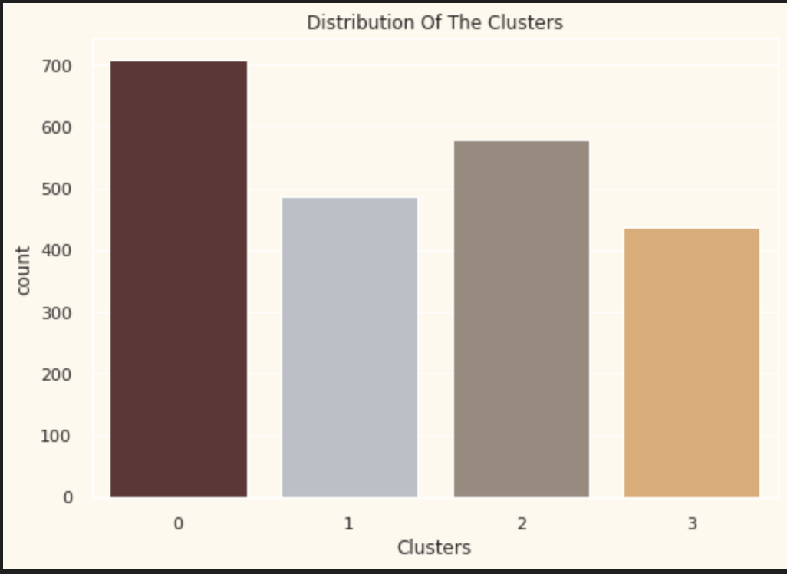
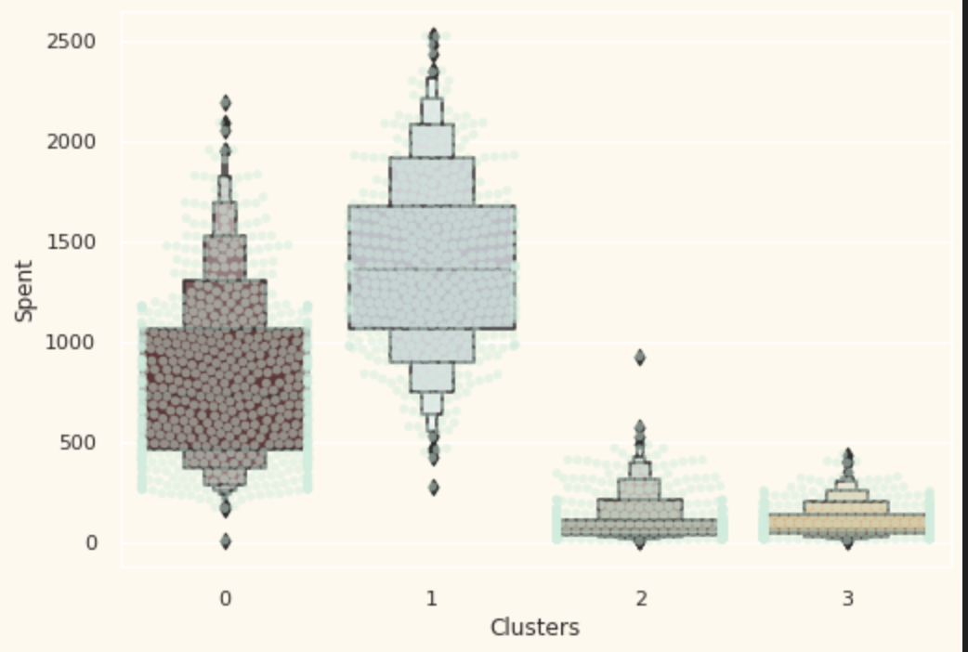
Evaluating the models

Slide 14
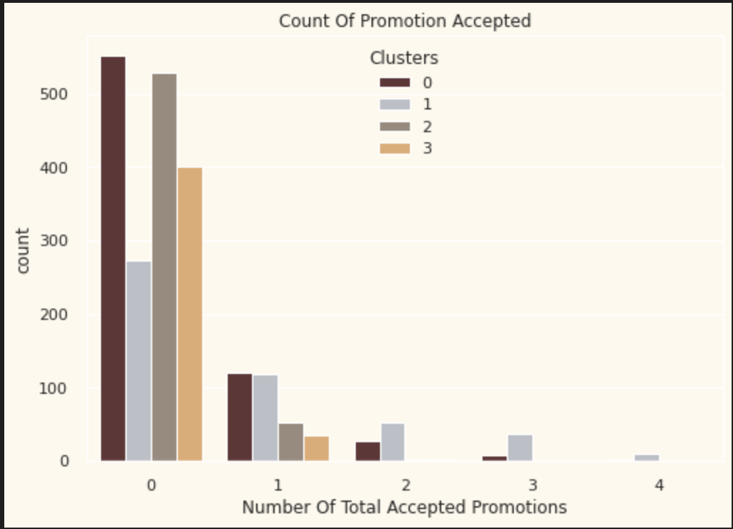
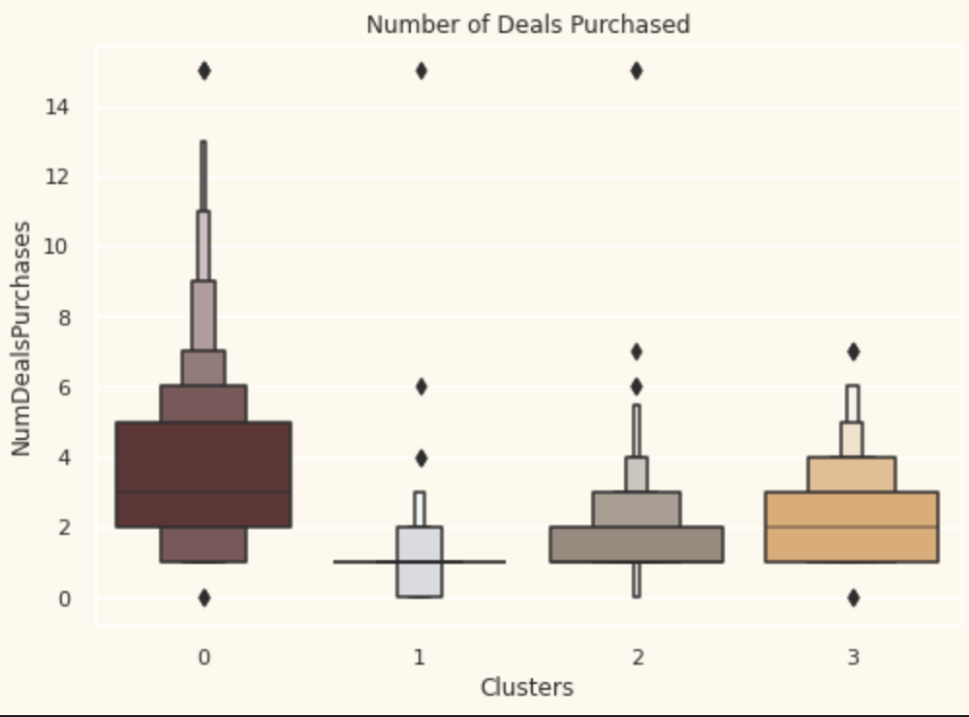
Evaluating the model

Slide 15
Profiling
Now that we have formed the clusters and looked at their purchasing habits. Let us see who all are there in these clusters. For that, we will be profiling the clusters formed and come to a conclusion about who is our star customer and who needs more attention from the retail store's marketing team. To decide that I will be plotting some of the features that are indicative of the customer's personal traits in light of the cluster they are in. On the basis of the outcomes, I will be arriving at the conclusions.

Slide 16
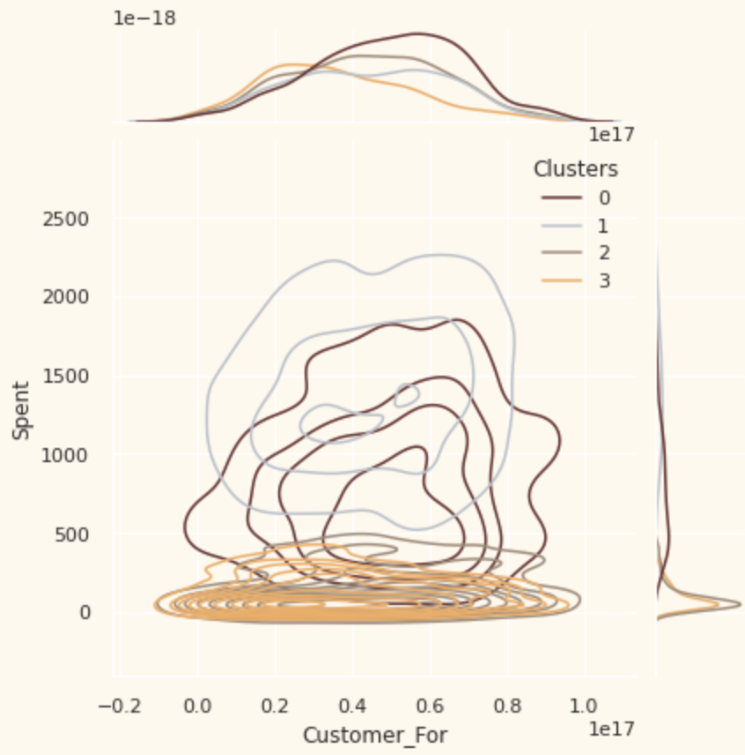
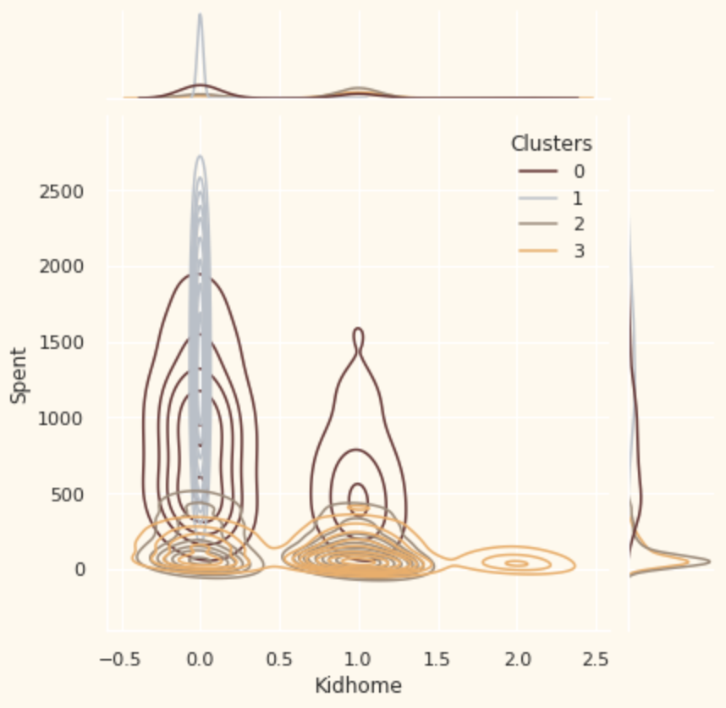
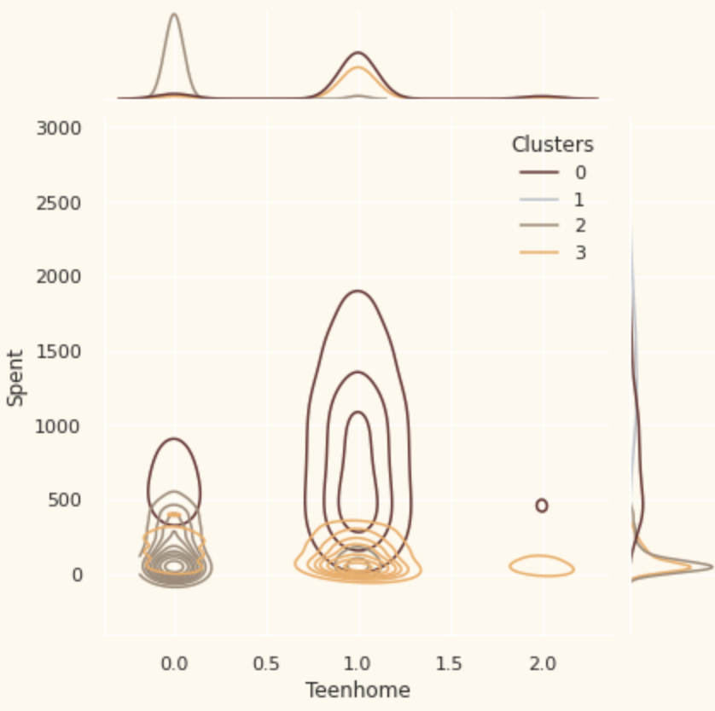

Slide 17
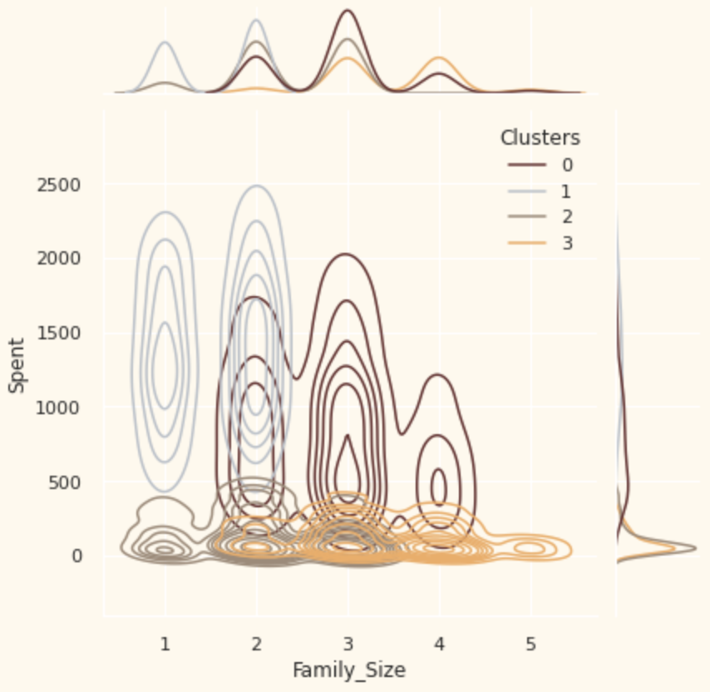
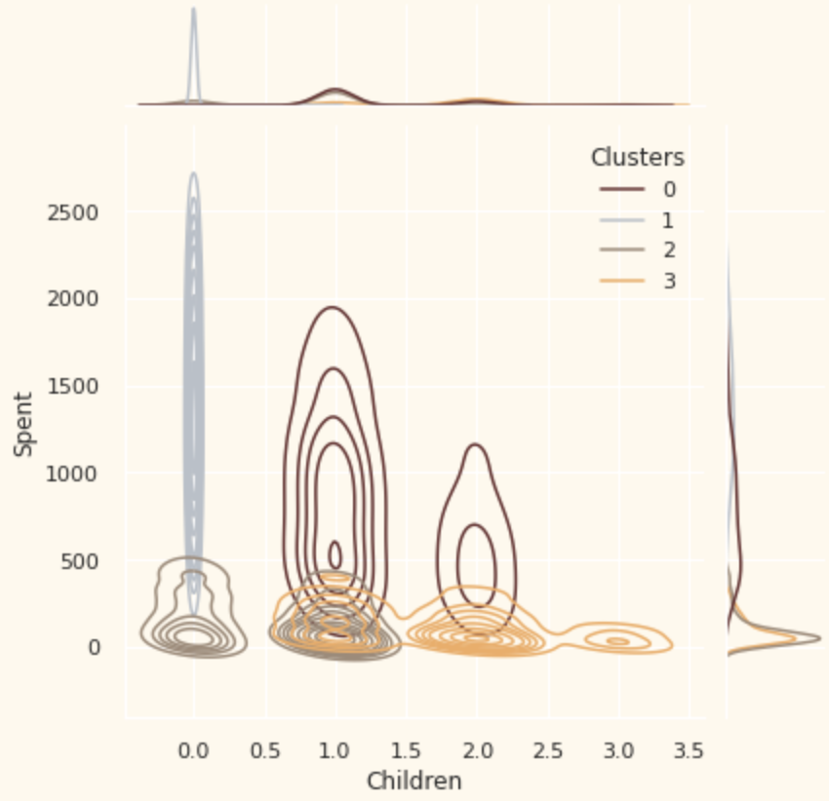
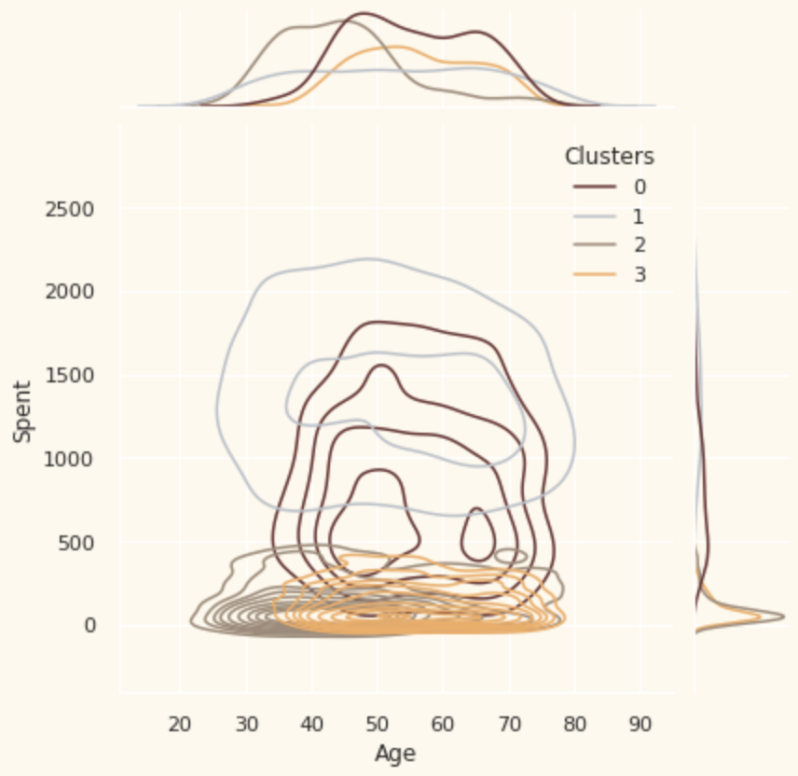

Slide 18
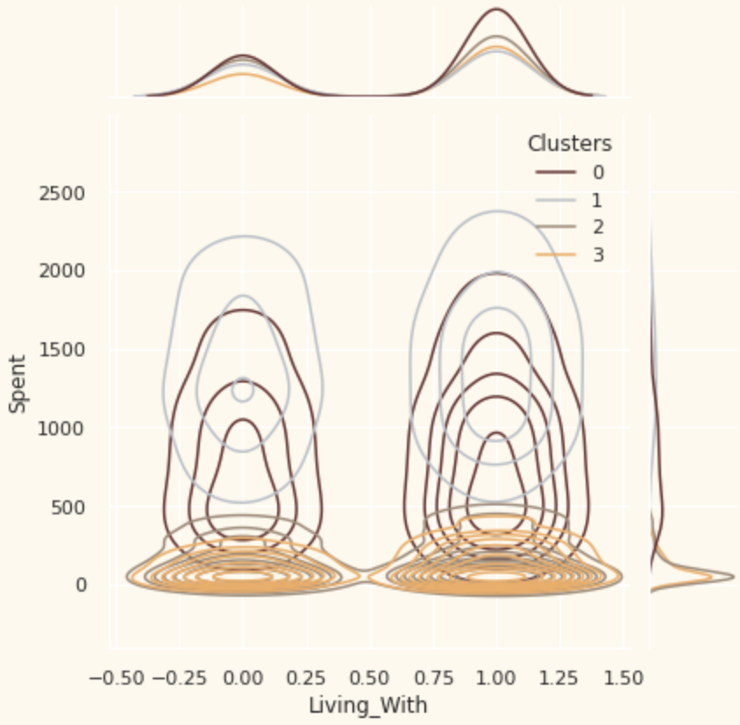
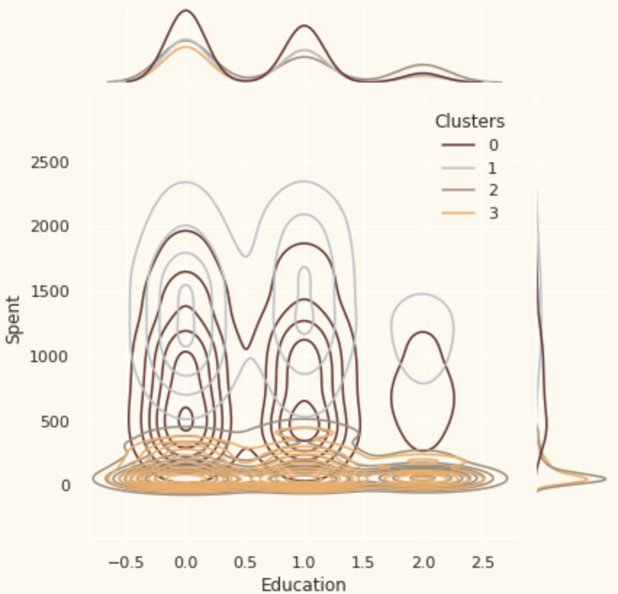
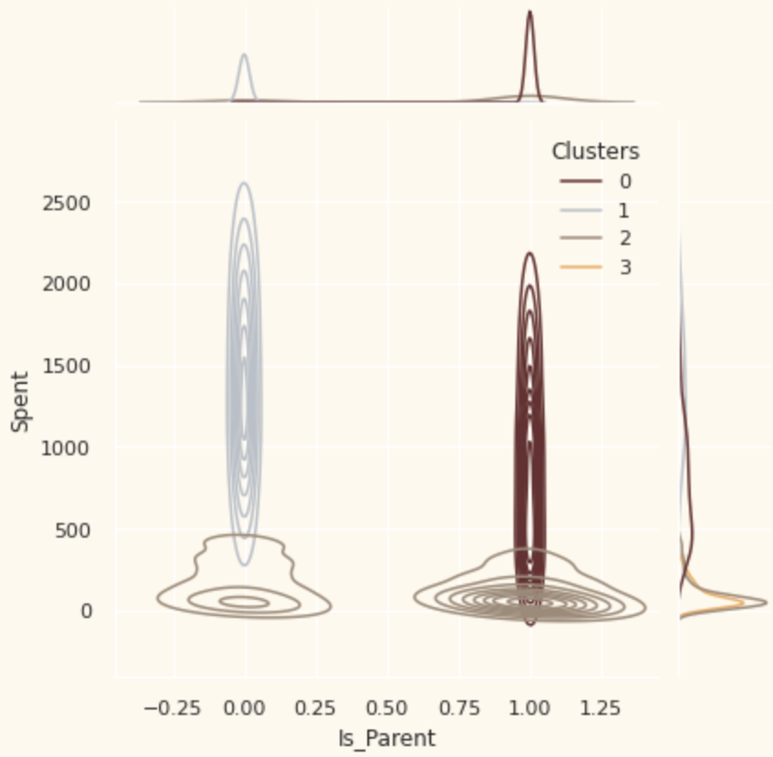

Slide 19
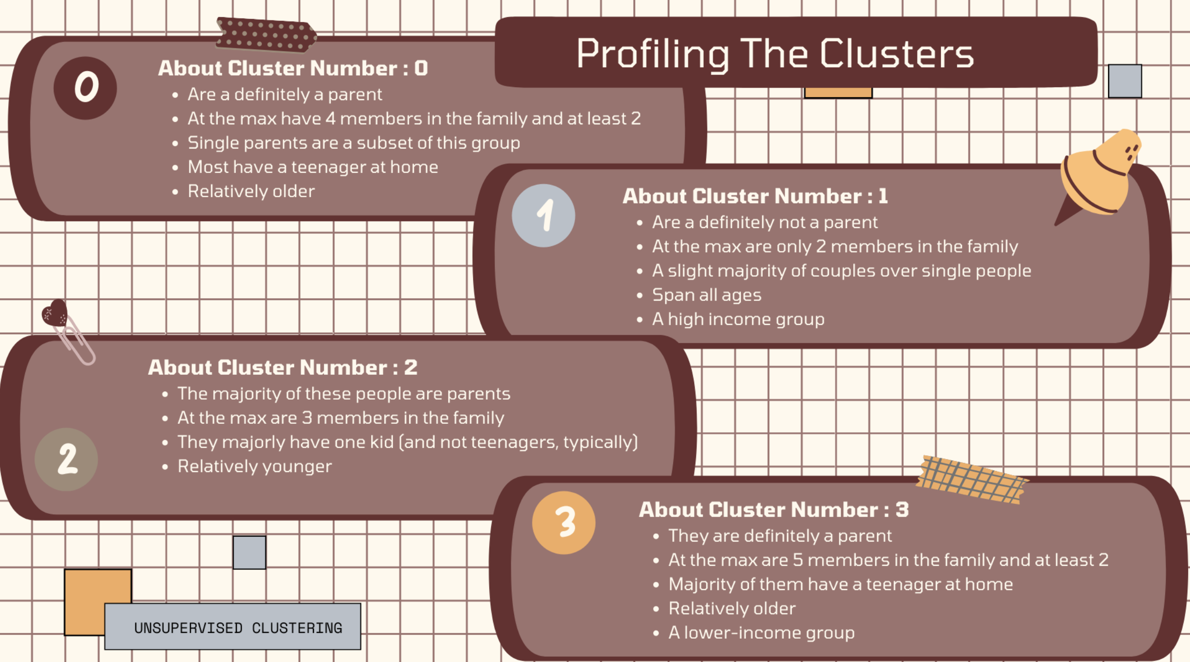

Slide 20

THANK YOU

